Slide 1
UE18CS390A – Capstone Project Phase – 1
SEMESTER - VI
END SEMESTER ASSESSMENT
Project Title :Forecasting future trending topics using text data.
Project ID : PW22DS03
Project Guide : Dinesh Singh
Project Team : Wise turtles
Members : Kavishankar K S PES1201802001
Mohammed Zeeshan PES1201801814
Rohan M PES1201801798

Slide 2
Problem Statement
Problem Statement:
Discovering trending topics from social media platforms and Forecasting the future trends based on the recent and past trend of the topics collected.

Slide 3
Abstract
Youtube , Google, and Twitter are often figures among the top 3 most popular application on website .
It has been reported Youtube users upload 72 hr videos / min.
So ,Forecasting content popularity is of great support and drive for design and management of various services.
our project is towards building ML model to forecast popular online content, using Various technique .
For this project we use past trending topic to train ML models for prediction future trendings.
Forecasting the future trending topics by using the recent and past trend data from social media sites like twitter, youtube and with the help of google trends.

Slide 4
Scope
Content Creators : Forecasting helps content creators to make a trending
contents on their platforms like Youtube .
Social Analysis: Analysis of interests by region and its lifespan. Any kind of
social analysis can help us gain an insight into the current psychology of the
people. This can help us determine how the public will react to some event
and make necessary preparations in advance.
Finance: Information related to companies and business magnates tend to
surface on social networks like YouTube , Google and Twitter even before the
official press release. These kinds of information can be useful in determining
the stock trends and ultimately even to predict stock prices.

Slide 5
Marketing: People often share their opinions on anything and everything. This
can be used to determine the interests of an individual or group. Based on
these interests products can be targeted to specific audiences in order to
maximize prot.
News Tracking: Information surfaces on YouTube , Google and Twitter very quickly. This
allows news and the updates regarding it to be available instantaneously. Since
These are a global platform, even international news can be updated in
real-time.
Thus extracting trends from YouTube , Google and Twitter can prove to be extremely
useful.

Slide 6
Literature survey
Paper 1: Using Early View Patterns to Predict the Popularity of YouTube Videos
In this study Multivariate Linear (ML) Model , MRBF Model and S-H Models are used to predict future trends in youtube.
By assigning different weights to different samples within the monitoring period, our model is able to better distinguish between videos with different patterns, which leads to significant reductions in average prediction errors.
We also found that by exploring the similarity between the video and known the training set through RBF functions, we are able to reduce prediction errors even further, by adapting the prediction to better handle some specific kinds of videos.

Slide 7
Literature survey
Paper 2: Twitter Trends
MapReduce model enhanced the speed of computing the vast amount of tweets and created a framework on which further analysis can be done.
In our case, the ( Latent Dirichlet Allocation ) LDA algorithm is used to process a set of documents(collections in database) of tweets prepared after the extraction and pooling process.
LDA provides us with a list of 'n' topics that constitute the documents. These topics are represented by a group of weighted words which can also be represented as a word cloud. Therefore, each word cloud
can be considered as a trending topic.
To improve the efficiency of the process, tweets containing the same entity are pooled together in the same document. The top 100 entities are considered for pooling.

Slide 8
Literature survey
Paper 3 :Topic discovery and future trend forecasting for texts
They used predict the next trending research topics based on corpus of research paper collected.
sentence-level pattern mining to discover meaningful topics.
Preprocessing using association analysis and LSA.
Used “WEKA” plugin which uses regression model for prediction.

Slide 9
Literature survey
Paper 4 : Forecasting Time Series Data Using Hybrid GREY Neural Network And ARIMA Model.
In this study,a combination of GRANN ARIMA is proposed as a new approach for hybridizing linear and nonlinear models.
The proposed model has few integrated features such as engaged with multivariate time series data.
Forecasting accuracy of the proposed hybrid model, GRANN ARIMA is better compared to the individual model such as GRANN, ARIMA, MR and the second order error, LVM.

Slide 10
Suggestions from Review - 3
No major suggestion were given in review -3

Slide 11
Design Constraints
Design Constraints:
As our project is based on real time data.For every result preprocessing and extraction of data is required.
Since we are using ML models to predict the future trends, we may need huge time and high computational power if we use large datasets to train the model.
A lot of time is consumed if we want to make changes to the model depending on the circumstances, since training the model requires a large amount of time.
We are dealing with text data which is indeed a big constraint since we can’t work on it, so we have to convert into some form before any process.
Extent of forecasting.

Slide 12
Assumptions
Assumptions:
The trending topics in future are based on the current and past trend.
The frequency of occurrence of topics is helps in predicting it’s trend.
Accuracy of chosen model is high.
Topics are low resolution and high sensitive.
Rising and falling of the topic do not have a long term spanning.

Slide 13
Dependency
Dependency:
Confounding variables in data.
Effects the both dependent and independent variable.
Correlation between topics.
Extent of relation between each topic.
Data Quality .
Large dataset and useful features in the dataset.
Temporal dependency.
Casual relationship b\w the topics.

Slide 14
Design Details
For data extraction the Project depends on platform
Twitter
Google trends
YouTube
Building User Interface.
Flask API
Module and Libraries like
Tensorflow and Keras
Platform for running and Testing.
Jupyter notebook
Google Collab
Data Storage.
Cloud storage.
Microservices for connecting process.

Slide 15
Design Details
Novelty.
The forecasting is used everywhere to progress, produce and provide things on demand.
Being able to tackle upcoming problems if they are initial known even if fairly.
Innovativeness.
The project more innovative where we are going to forecast trends of various major fields and we are trying to predicting ramification may arise from upcoming trend.
Interoperability.
System can able to exchange data with cloud storage and user for results and within the system.

Slide 16
Design Details
Maintainability
Since the system is to be designed in fully automated way there where less maintainability.
Portability
Highly portable and can be run in browser.
Legacy to modernization.
It highly valuable wealth in the field of decision making, forecasting demands and precautions can be taken based on trend.
Performance
Should be very high to interpret the results in real time.

Slide 17
Proposed Methodology / Approach
Data Extraction:
Web scraping
Using API's- provided by different social media platforms mainly from twitter, google trends and YouTube.
2. Preprocessing
Normalisation- remove noise from the data.
Removal of:
stop words:Commonly occurring words.
stemming: reducing word into root form.
3. Text Classification:
NLP: classifying the topic to domain it belongs
Pattern/rule based classifier.
SVM classifiers.
Word2vec.

Slide 18
Proposed Methodology / Approach
4. Future Selection for text classification:
Optimizing a model by selecting a subset of the features to use.
Reducing the overfitting of the dataset.
Wrapper method-Wrapping methods compute models with a certain subset of features and evaluate the importance of each feature.
5. Forecasting and modelling :
Poison process:
variation of the particular topic over the time period.
Markov chain:
trend analysis over period of time.
Apriori algorithm- Conversion of transaction into frequent item set.
Hybrid Model - for forecasting the trends.
Clustering for violation detection.

Slide 19

Proposed Methodology / Approach
6.Testing
RMSE:
The model accuracy is evaluated using the RMSE.
7.Interpreting the result.
Visual graphs.
Future Trend Score.

Slide 20
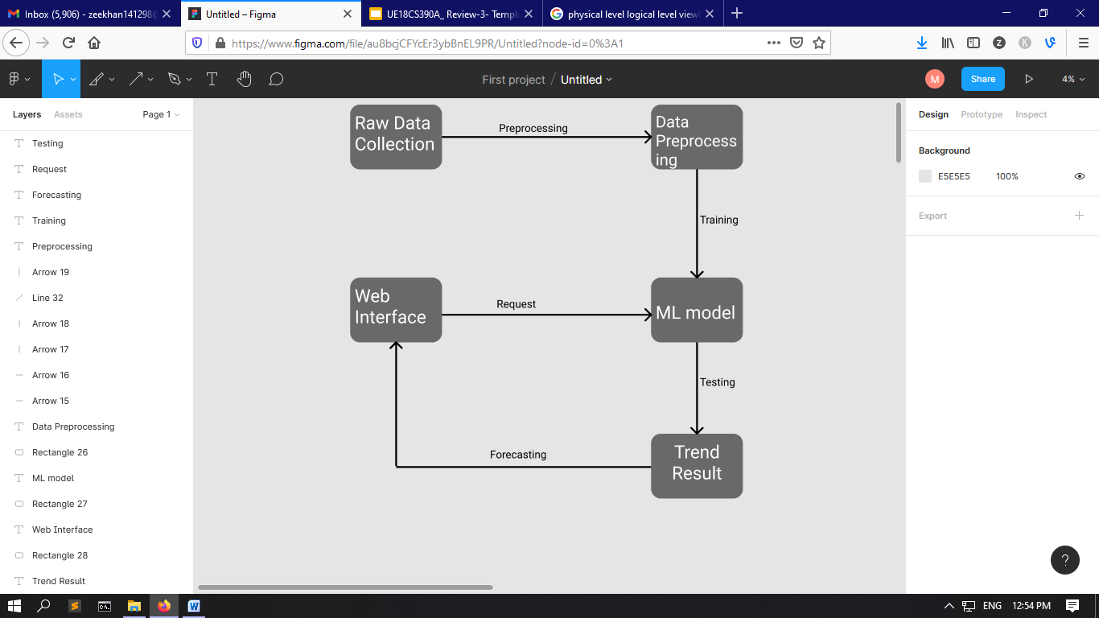
Architecture

Slide 21
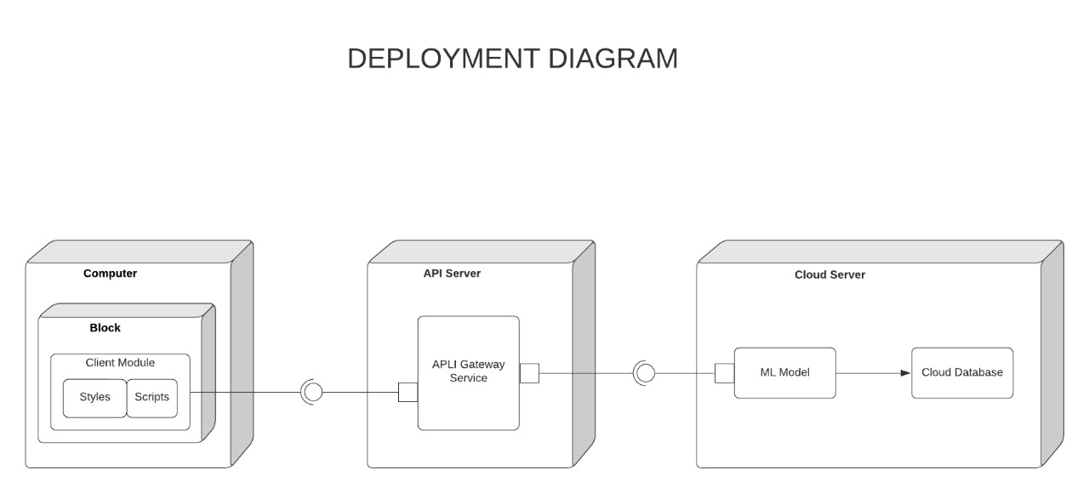
Architecture

Slide 22
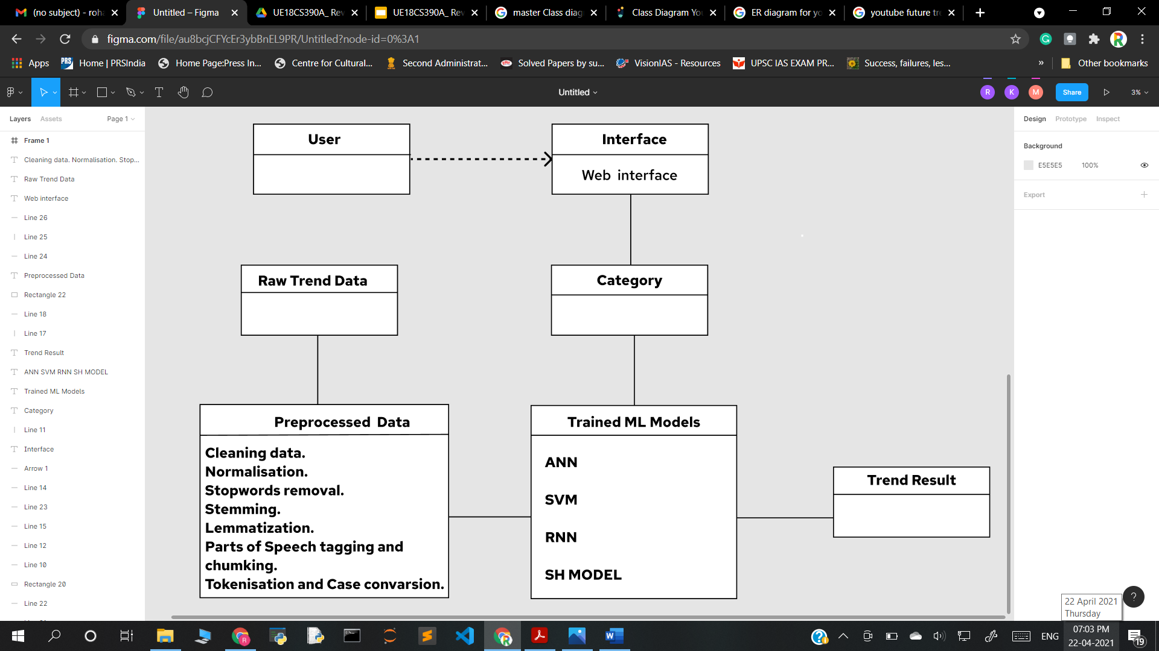
Master Class Diagram

Slide 23
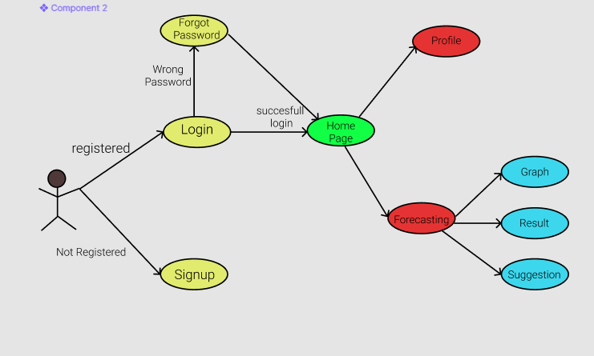
Use Case Diagram

Slide 24
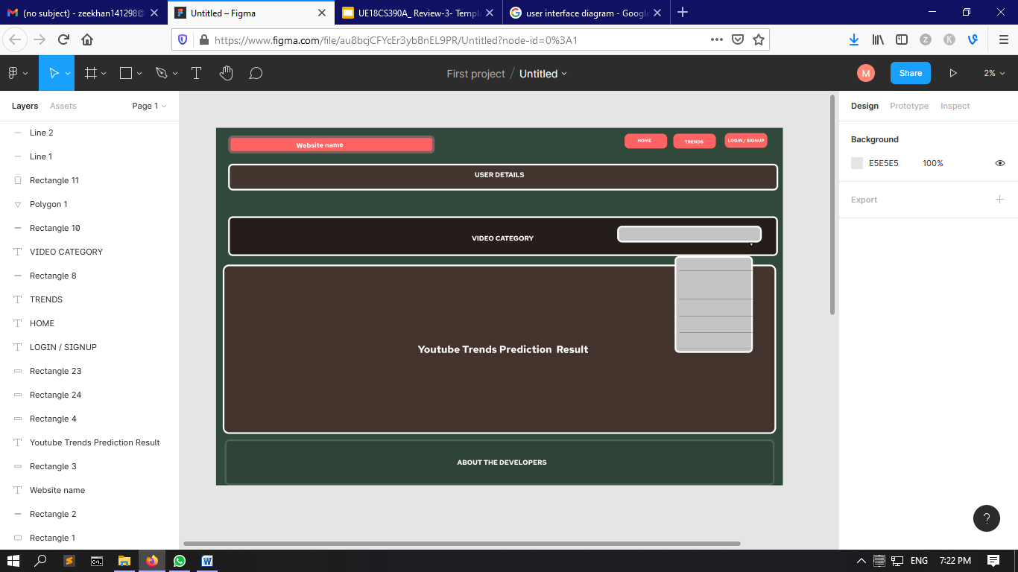
User Interface

Slide 25
Technologies Used
Data Extraction:
Using the web scraping.
Python Beautiful Soup.
Using the api’s provided by specific social media websites.
Twitter Developer API
Youtube API
Google Trends API
Data preprocessing:
Using NLP techniques.
Normalisation.
Stopping and Stemming.
POS Tagger.
Lemmatisation

Slide 26
Technologies Used
Forecasting:
Methodes
Statistical mode
Artificial Intelligence
Data analytics techniques.
ARIMA
MR
Hybrid model
GRAN-ARIMA.
Visualization tools:
Generating real time graphs.
Python Libraries like matplotlib and Pyplot.
WordCloud
Generating cloud of words.

Slide 27
Technologies Used
Flask:
Web application
Machine learning model deployment.
Data Storage
Storing data in cloud.
Testing
Pycharm.
Jupyter.
Google Colab.

Slide 28
Project Progress
1. Data collection using web scraping and API’s of social networking
platforms.
2. Preprocessing of data.
3. Currently working on choosing and building Machine Learning
Model,based on the literature survey .
4. Analysis of Gathered data.
About 30% of the project has been completed till now.

Slide 29
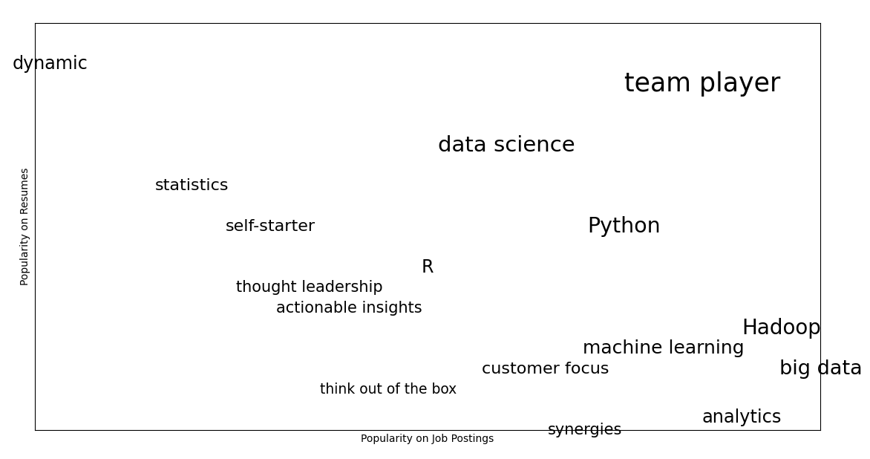
Word Cloud :

Slide 30
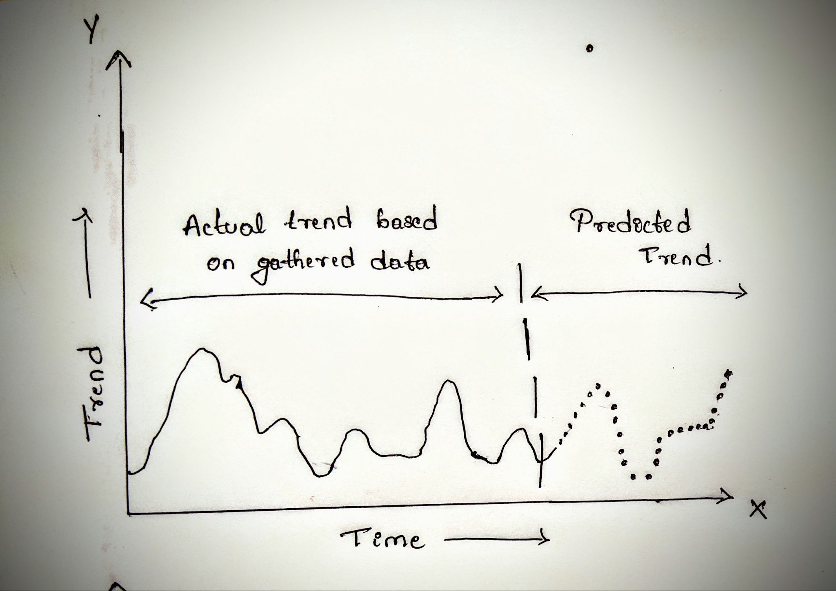
Final interpretation of result
Available data is plotted in solid line and predicted data is plotted in dotted line.

Slide 31
Demo
Pseudocode :
1.Extract data from social networks using web scraping and api’s.
2.Preprocess Data using NLP and Normalisation ,Removal of POS, stop words, stemming etc.
3.Using extracted Data build a model for training
4.Train the model.
5.Test the trained Model and update the model as required.

Slide 32
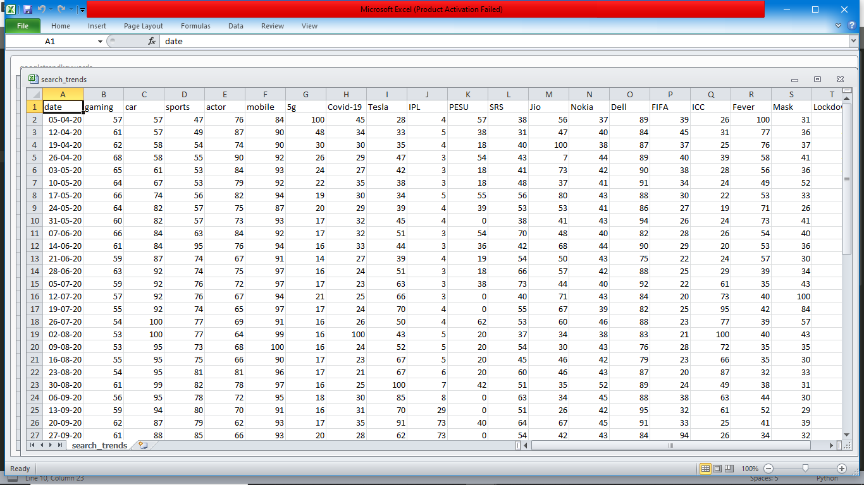
Search Data Extracted From Google Trends using API :

Slide 33
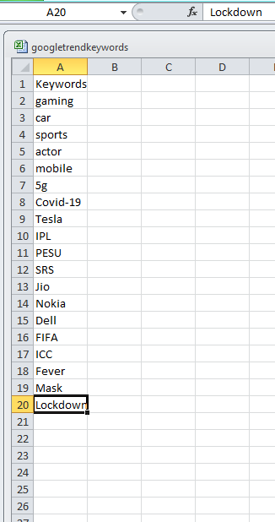
Keyword Used
.

Slide 34
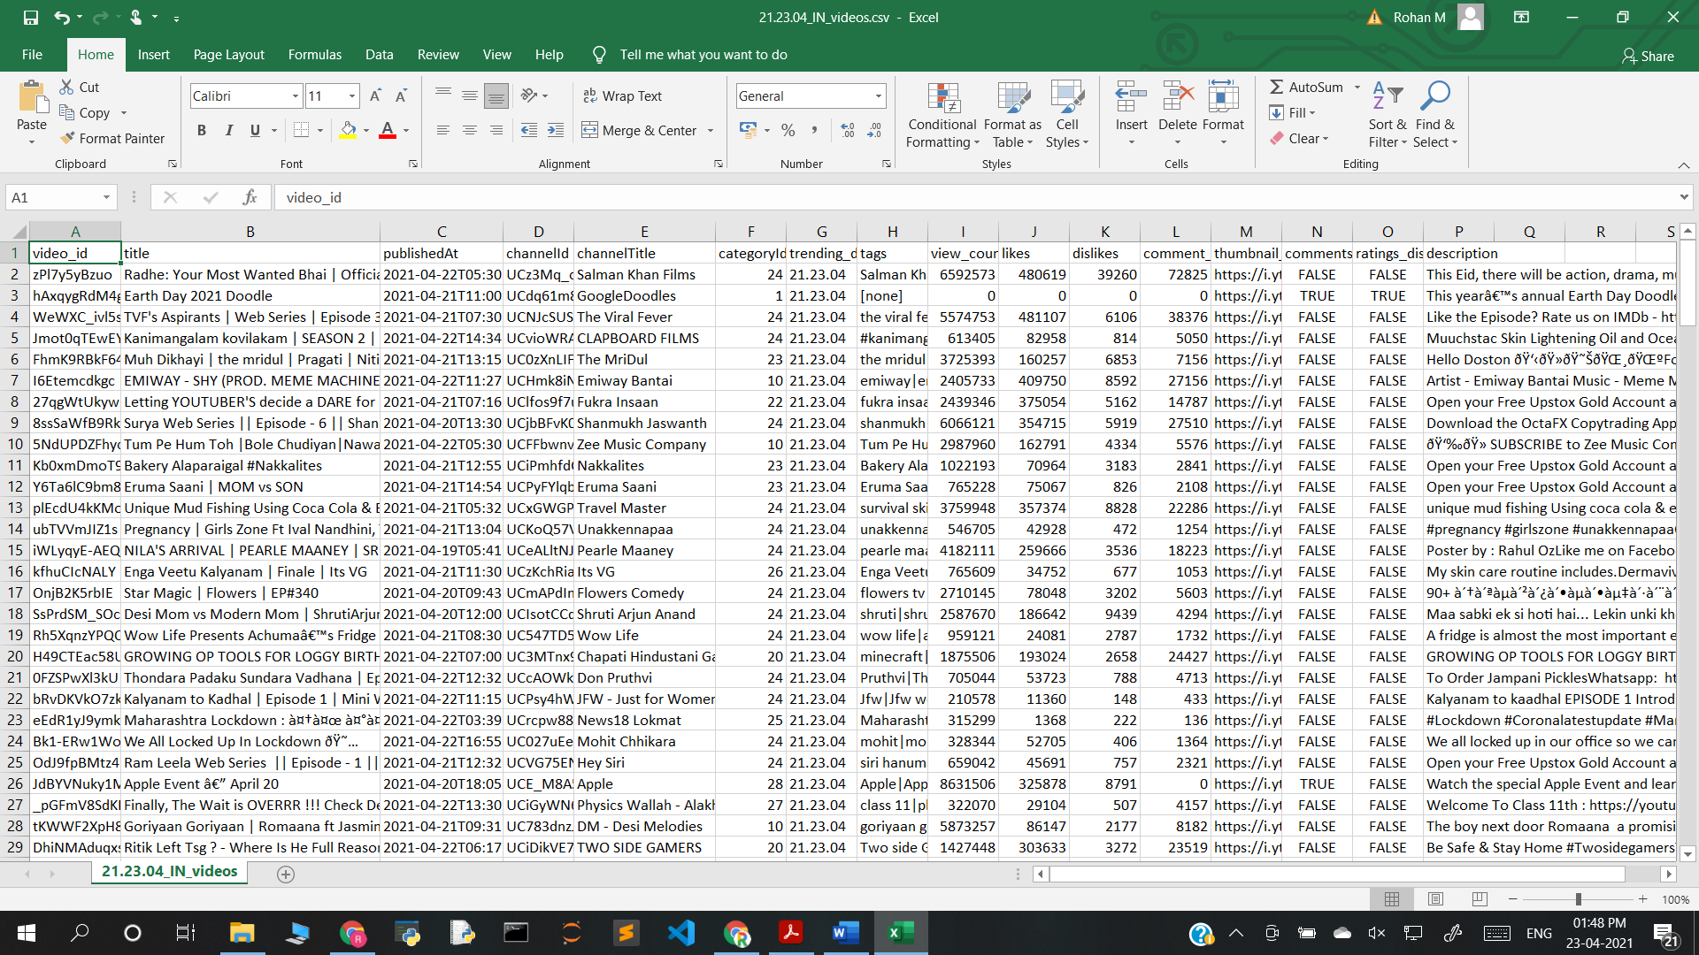
Search Data Extracted From Youtube using API :

Slide 35
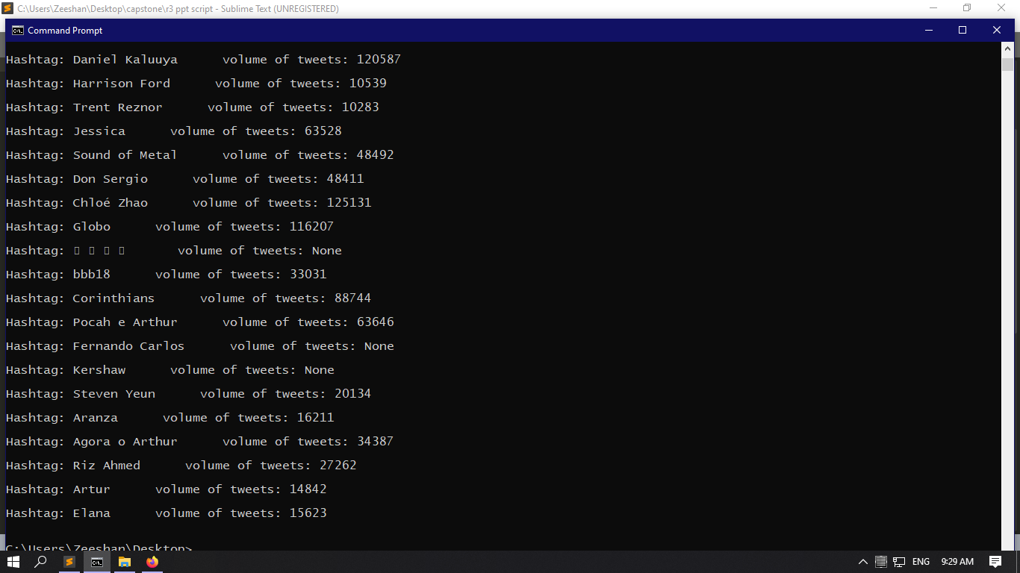
Data extracted from twitter trends :

Slide 36
Summary of work done in Capstone Phase-1
Collection of research paper in this subject- Jan/21
Analysis of Collected research paper along with team-Feb/21
Formalisation of extraction data using API and Finding API’s Feb/21
Data Extraction using API and Discussion on model for forecasting -Mar/21
Discussion on interpreting results and microservices - Apr/21
Discussion on what additional things can be added -Apr/21
Preparing to make project to tackle business problems -Apr/21

Slide 37
Project Plan for Capstone Phase-2
Finding the method to organize all the extracted data.
Extensive Preprocessing of the collected Data.
Extraction and Classification of the topics from data.
Feature selection from the data.
Building models for forecasting of text data.
Training and Evaluating model.
Building a user interface.

Slide 38
References
References:
Jose L. Hurtado*† , Ankur Agarwal† and Xingquan Zhu†,
”Topic discovery and future trend forecasting for texts”
2. Roselina Sallehuddin, Siti Mariyam Hj. Shamsuddin, Siti Zaiton Mohd. Hashim,,Ajith Abrahamy, “Forecasting Time Series Data Using Hybrid GREY Neural Network And ARIMA Model”.

Slide 39
References
3. “YouTube View Prediction with Machine Learning”
Int. J. Business Information Systems, Vol. 13, No. 3, 2013 359
4. Conrad Tucker1 and Harrison M. Kim1 (1)
“PREDICTING EMERGING PRODUCT DESIGN TREND BY MINING PUBLICLY AVAILABLE CUSTOMER REVIEW DATA”.- University of Illinois at Urbana-Champaign, USA.

Slide 40
Thank You

